Slide 1
The Foundations: Logic and Proofs
Chapter 1, Part I: Propositional Logic
With Question/Answer Animations

Slide 2
Chapter Summary
Propositional Logic
The Language of Propositions
Applications
Logical Equivalences
Predicate Logic
The Language of Quantifiers
Logical Equivalences
Nested Quantifiers
Proofs
Rules of Inference
Proof Methods
Proof Strategy

Slide 3
Propositional Logic Summary
The Language of Propositions
Connectives
Truth Values
Truth Tables
Applications
Translating English (Arabic) Sentences
System Specifications
Logic Puzzles
Logic Circuits
Logical Equivalences
Important Equivalences
Showing Equivalence
Satisfiability

Slide 4
Propositional Logic
Section 1.1

Slide 5
Section Summary
Propositions
Connectives
Negation
Conjunction
Disjunction
Implication; contrapositive, inverse, converse
Biconditional
Truth Tables

Slide 6
Propositions
A proposition is a declarative (declares a fact) sentence that is either true or false.
Examples of propositions:
The Moon is made of cheese.
Alexandria is the capital of Egypt.
Damascus is the capital of Syria.
1 + 0 = 1
0 + 0 = 2
Examples that are not propositions.
Sit down! What time is it?
x + 1 = 2 x + y = z

Slide 7
Any proposition p is either true or false
p
T
F

Slide 8
Propositional Logic
Constructing Propositions
Propositional Variables: p, q, r, s, …
To represent propositions.
E.g. p : Alexandria is the capital of Egypt
The proposition that is always true is denoted by T and the proposition that is always false is denoted by F.
Compound Propositions; constructed from logical connectives and other propositions
Negation ¬
Conjunction ∧
Disjunction ∨
Implication →
Biconditional ↔

Slide 9
Propositional Logic
Alexandria is the capital of Egypt
1 + 0 = 1
It is not the case that Alexandria is the capital of Egypt
Alexandria is the capital of Egypt and 1 + 0 = 1
Alexandria is the capital of Egypt or 1 + 0 = 1
If Alexandria is the capital of Egypt then 1 + 0 = 1

Slide 10
Propositional Logic
p: Alexandria is the capital of Egypt
q: 1 + 0 = 1
It is not the case that Alexandria is the capital of Egypt
¬ p (Not p)
Alexandria is the capital of Egypt and 1 + 0 = 1
p ∧ q (p and q)
Alexandria is the capital of Egypt or 1 + 0 = 1
p ∨ q (p or q)

Slide 11
Compound Propositions: Negation
The negation of a proposition p is denoted by ¬p
p : The earth is round
¬p : It is not the case that the earth is round
The earth is not round
and has this truth table:
p | ¬p
T | F
F | T

Slide 12
Conjunction
The conjunction of propositions p and q is denoted by p ∧ q
p : I am at home
q : It is raining
p ∧q : I am at home and it is raining.
p | q | p ∧ q
T | T | T
T | F | F
F | T | F
F | F | F

Slide 13
q
T
T
p
q
F
q
T
F
q
F

Slide 14
r
q
T
T
T
r
F
p
q
r
T
F
r
F
q
r
T
T
F
r
F
q
r
T
F
r
F

Slide 15
Disjunction
The disjunction of propositions p and q is denoted by p ∨ q
p : I am at home
q : It is raining
p ∨ q : I am at home or it is raining.
p | q | p ∨ q
T | T | T
T | F | T
F | T | T
F | F | F

Slide 16
Disjunction
The disjunction of propositions p and q is denoted by p ∨q and has this truth table:
Example: If p denotes “I am at home.” and q denotes “It is raining.” then p ∨q denotes “I am at home or it is raining.”
p | q | p ∨q
T | T | T
T | F | T
F | T | T
F | F | F

Slide 17
The Connective Or in English
In English “or” has two different meanings.
“Inclusive Or” ∨
“Dr. Ali or Dr Maha will teach discrete mathematics course”
For p ∨q to be true, either one or both of p and q must be true.

Slide 18
The Connective Or in English
“Exclusive Or (Xor).” ⊕
“Soup or salad comes with this meal”
Do not expect to be able to get both soup and salad.
In p ⊕ q , one of p and q must be true, but not both.
The truth table for ⊕
p | q | p ⊕q
T | T | F
T | F | T
F | T | T
F | F | F

Slide 19
Implication
p : “I am at home.”
q : “I am ill.”
p →q : “If I am at home then I am ill.”
In p →q ,
p is the hypothesis (antecedent or premise)
q is the conclusion (or consequence).

Slide 20
Implication
If p and q are propositions, then p →q is a
conditional statement or implication
read as “if p, then q ” and has this truth table:
p | q | p →q
T | T | T
T | F | F
F | T | T
F | F | T

Slide 21
Understanding Implication
One way to view the logical conditional is to think of an obligation or contract.
“If I am elected, then I will lower taxes.”
If the politician is elected and does not lower taxes, then the voters can say that he or she has broken the campaign pledge.
This corresponds to the case where p is true and q is false.

Slide 22
Different Ways of Expressing p →q
if p, then q p implies q
if p, q p only if q
q unless ¬p q when p
q if p q whenever p
p is sufficient for q
q follows from p q is necessary for p
a necessary condition for p is q
a sufficient condition for q is p

Slide 23
Biconditional
If p and q are propositions, then we can form the biconditional proposition p ↔q , read as “p if and only if q .” The biconditional p ↔q denotes the proposition with this truth table:
p | q | p ↔q
T | T | T
T | F | F
F | T | F
F | F | T

Slide 24
Biconditional
p : “I am at home.”
q : “It is raining.”
p ↔q: “I am at home if and only if it is raining.”

Slide 25
Expressing the Biconditional
“p if and only if q” is expressed in English:
p is necessary and sufficient for q
if p then q , and conversely
p iff q

Slide 26
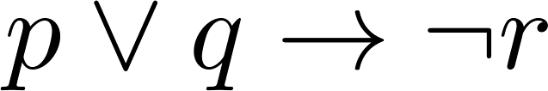
Truth Tables For Compound Propositions
Construct a truth table for
p | q | r | ¬r | p ∨ q | p ∨ q → ¬r
T | T | T | F | T | F
T | T | F | T | T | T
T | F | T | F | T | F
T | F | F | T | T | T
F | T | T | F | T | F
F | T | F | T | T | T
F | F | T | F | F | T
F | F | F | T | F | T

Slide 27
Precedence of Logical Operators
Operator | Precedence
¬ | 1
∧ ∨ | 2 3
→ ↔ | 4 5
p ∨q → ¬r is equivalent to (p ∨q) → ¬r
If the intended meaning is p ∨(q → ¬r )
then parentheses must be used.

Slide 28
Applications of Propositional Logic

Slide 29
Applications of Propositional Logic
Translating English to Propositional Logic
System Specifications
Boolean Searching on the Internet
Logic Puzzles
Logic Circuits
Expert Systems
….

Slide 30
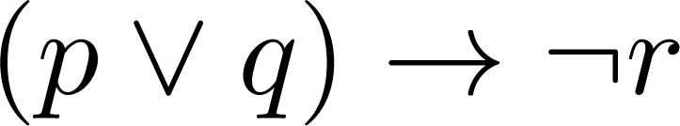
Translating English Sentences
Steps to convert an English sentence to a statement in propositional logic
Identify atomic propositions and represent using propositional variables.
Determine appropriate logical connectives
“If I go to McDonald or to PizzaHut, I will not go shopping.”
p: I go to McDonald
q: I go to PizzaHut.
r: I will go shopping.
If p or q then not r.

Slide 31
Example
Problem: Translate the following sentence into propositional logic:
“You can access the Internet at EUI only if you are a student or you are staff member.”
One Solution: Let a, c, and f represent respectively “You can access the internet at EUI,” “You are a student,” and “You are a staff member.”
a→ (c ∨ f )

Slide 32
If I was reading the newspaper in the kitchen, then my glasses are on the kitchen table.
p: I was reading the newspaper in the kitchen
q: my glasses are on the kitchen table
p → q
If my glasses are on the kitchen table, then I saw them at breakfast.
r: my glasses are on the kitchen table
s: I saw them at breakfast
r → s

Slide 33
I did not see my glasses at breakfast.
u: I saw my glasses at breakfast.
¬u
I was reading the newspaper in the living room or I was reading the newspaper in the kitchen.
If I was reading the newspaper in the living room then my glasses are on the coffee table.

Slide 34
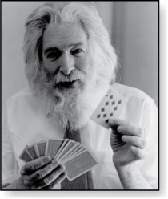
Logic Puzzles
Raymond Smullyan
(Born 1919)
An island has two kinds of inhabitants, knights, who always tell the truth, and knaves, who always lie.
You go to the island and meet A and B.
A says “B is a knight.”
B says “The two of us are of opposite types.”
Example: What are the types of A and B?
Solution: Let p and q be the statements that A is a knight and B is a knight, respectively. So, then ¬p represents the proposition that A is a knave and ¬q that B is a knave.
If A is a knight, then p is true. Since knights tell the truth, q must also be true. Then (p ∧ ¬ q)∨ (¬ p ∧ q) would have to be true, but it is not. So, A is not a knight and therefore ¬p must be true.
If A is a knave, then B must not be a knight since knaves always lie. So, then both ¬p and ¬q hold since both are knaves.

Slide 35
END of WEEK 1

Slide 36
Propositional Equivalences
Section 1.2

Slide 37
What we studied so far
Proposition
Truth value of a proposition (either T or F)
Compound proposition using logical operators:
Truth table
Operator | Meaning
¬ | not
∧ ∨ | and or
→ ↔ | If then If and only if

Slide 38
Section Summary
Tautologies, Contradictions, and Contingencies.
Logical Equivalence
Important Logical Equivalences
Showing Logical Equivalence
Normal Forms (optional, covered in exercises in text)
Disjunctive Normal Form
Conjunctive Normal Form
Propositional Satisfiability
Sudoku Example

Slide 39
Tautologies, Contradictions, and Contingencies
A tautology is a proposition which is always true.
Example: p ∨¬p
A contradiction is a proposition which is always false.
Example: p ∧¬p
A contingency is a proposition which is neither a tautology nor a contradiction, such as p
P | ¬p | p ∨¬p | p ∧¬p
T | F | T | F
F | T | T | F

Slide 40
Logically Equivalent
Two compound propositions p and q are logically equivalent if p↔q is a tautology.
We write this as p⇔q or as p≡q where p and q are compound propositions.
Two compound propositions p and q are equivalent if and only if the columns in a truth table giving their truth values agree.

Slide 41
Logically Equivalent
¬p ∨ q is equivalent to p → q.
p | q | ¬p | ¬p ∨ q | p→ q
T | T | F | T | T
T | F | F | F | F
F | T | T | T | T
F | F | T | T | T

Slide 42
Converse, Contrapositive, and Inverse
From p →q we can form new conditional statements .
q →p is the converse of p →q
¬ p → ¬ q is the inverse of p →q
¬q → ¬ p is the contrapositive of p →q

Slide 43
Find the converse, inverse, and contrapositive of
“It is raining is a sufficient condition for me to stay at home.”
If it is raining then I stay at home
p q
Converse (q →p) :
If I stay at home, then it is raining.
Inverse (¬ p → ¬ q ) :
If it is not raining, then I will not stay at home ( I go out).
Contrapositive (¬q → ¬ p ) :
If I don’t stay at home (I go out), then it is not raining.

Slide 44
p →q is not logically equivalent to ¬ p →¬ q
p →q is logically equivalent to ¬ q → ¬ p
p | q | ¬ p | ¬ q | p →q | ¬ p → ¬q | ¬q → ¬ p
T | T | F | F | T | T | T
T | F | F | T | F | T | F
F | T | T | F | T | F | T
F | F | T | T | T | T | T

Slide 45
Is p →q logically equivalent to q → p ?
NO
p | q | p →q | q → p
T | T | T | T
T | F | F | T
F | T | T | F
F | F | T | T

Slide 46
Find the negation of p → q
p → q (¬p ∨ q)
¬(p → q) ¬(¬p ∨ q)

Slide 47
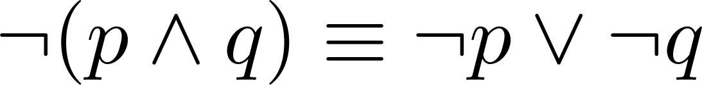
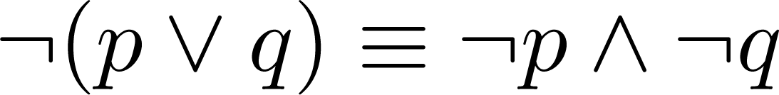
De Morgan’s Laws
This truth table shows that De Morgan’s Second Law holds.
p | q | ¬p | ¬q | (p∨q) | ¬(p∨q) | ¬p∧¬q
T | T | F | F | T | F | F
T | F | F | T | T | F | F
F | T | T | F | T | F | F
F | F | T | T | F | T | T

Slide 48
Find the negation of p → q
p → q (¬p ∨ q)
¬(p → q) ¬(¬p ∨ q)
p ∧ ¬q
If it is raining then I stay at home
It is raining and I do not stay at home

Slide 49
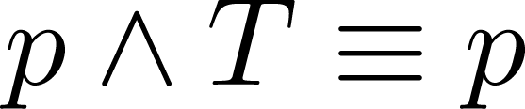
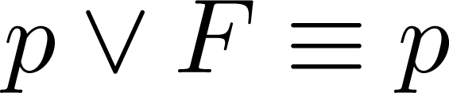
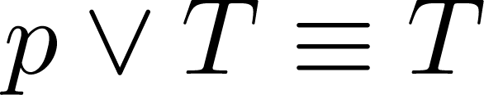
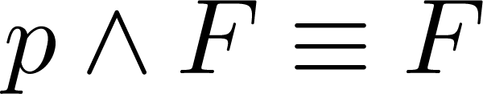
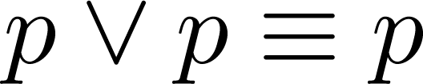
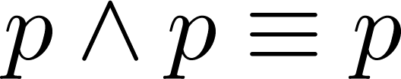
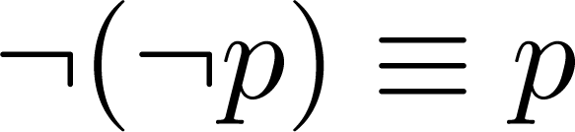
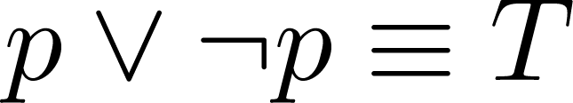
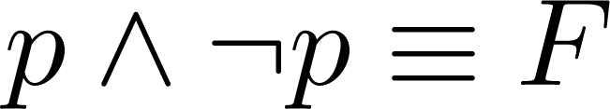
Key Logical Equivalences
Identity Laws: ,
Domination Laws: ,
Idempotent laws: ,
Double Negation Law:
Negation Laws: ,

Slide 50
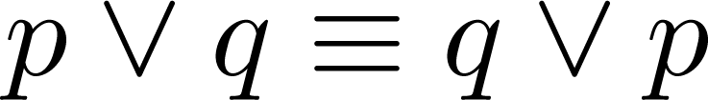
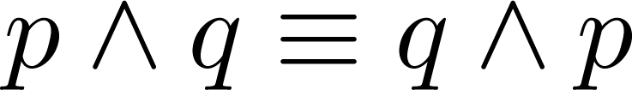
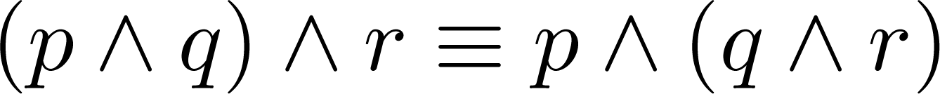
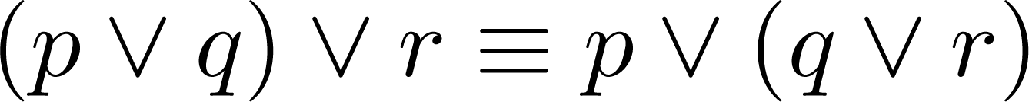
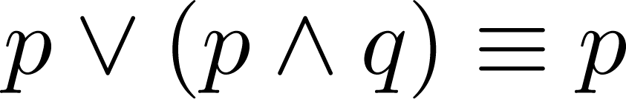
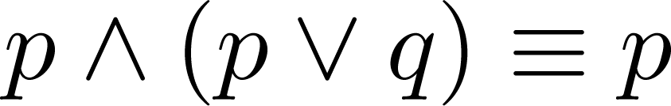
Key Logical Equivalences (cont)
Commutative Laws: ,
Associative Laws:
Distributive Laws:
Absorption Laws:

Slide 51
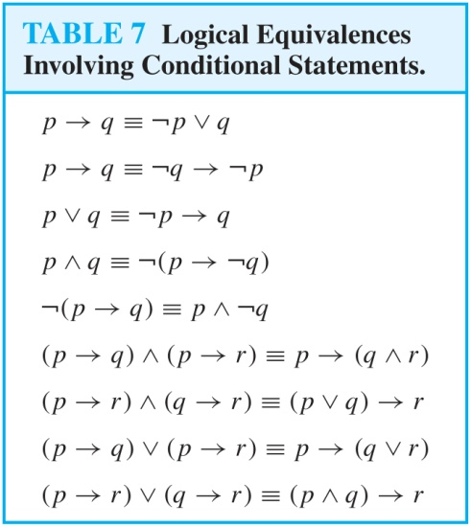
More Logical Equivalences

Slide 52
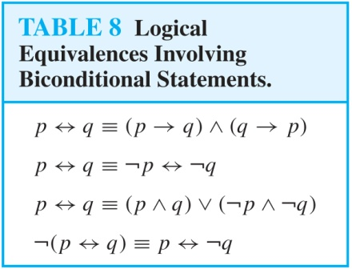
More Logical Equivalences

Slide 53

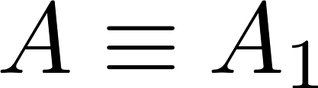
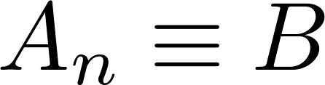
Constructing New Logical Equivalences
We can show that two expressions are logically equivalent by developing a series of logically equivalent statements.
To prove that we produce a series of equivalences beginning with A and ending with B.
Keep in mind that whenever a proposition (represented by a propositional variable) occurs in the equivalences listed earlier, it may be replaced by an arbitrarily complex compound proposition.

Slide 54
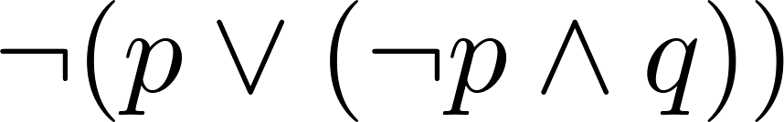
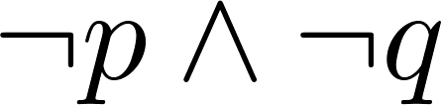
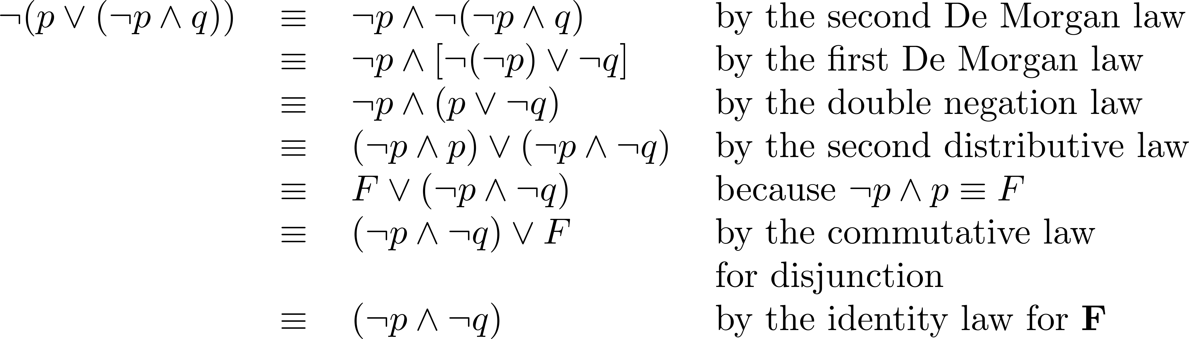
Equivalence Proofs
Example: Show that
is logically equivalent to
Solution:

Slide 55
Equivalence Proofs
Show that is logically equivalent to
Solution:
¬(p ∨ (¬p ∧ q) ¬p ∧ ¬(¬p ∧ q) DeMorgan law
¬p ∧ [¬(¬p) ∨ ¬q] DeMorgan law
¬p ∧ (p ∨ ¬q) Double negation
(¬p ∧ p) ∨ (¬p ∧ ¬q) Distributive
F ∨ (¬p ∧ ¬q)
(¬p ∧ ¬q) ∨ F
(¬p ∧ ¬q)

Slide 56
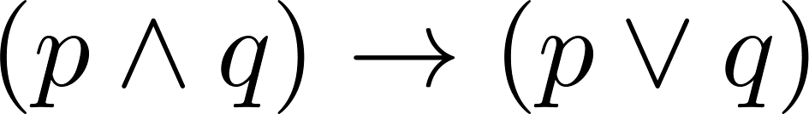
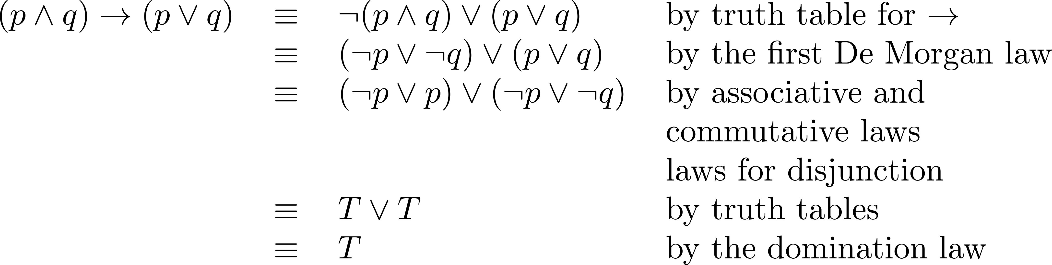
Equivalence Proofs
: Show that is a tautology.
Solution:

Slide 57
Show that p → (q → r) is equivalent to ( p ∧ q) → r
p → (q → r) p →(¬q ∨ r)
¬p ∨ (¬q ∨ r)
(¬p ∨ ¬q ) ∨ r
¬ (p ∧ q) ∨ r
( p ∧ q) → r

